Slide 1
MNCH2 Learning Event on accountability: Break-out session 1 Establishing sustainable health care financing policies and structures: overcoming barriers in MNCH2 supported States
Katsina, 30 October 2018

Slide 2
Lets not forget…
Every healthcare system must fulfill certain fundamental objectives in order to ensure the health and well-being of the population it serves:
Mobilising resources for improving the health of its constituents;
Providing protection from financial hardship in the event of catastrophic illness; and
Achieving allocative efficiency and equity in the provision of health care.
(OPPI Ashoke S. Bhattacharjya and Elizabeth Fowler)

Slide 3
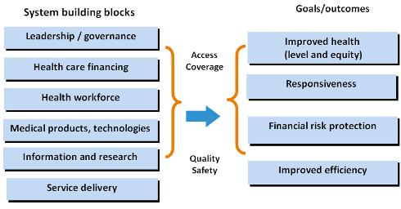
Health Financing is the Fulcrum of Health Systems

Slide 4
Consideration in SHF
MMR - 576
IMR - 69
Stunting – 37%
OPE - >72.2%
Poverty index – 53.7% (NW-81% and NE-76.8%)

Slide 5
Current sources of health financing
Out of Pocket - >70%
Government budget
Donors
Prepayment mechanisms
– Does budgetary allocation translate into release/utilisation

Slide 6
Status of SHF
Status
Kano | Law passed and signed Agency formed Operational documents developed Implementation ongoing
Kaduna | Law passed and signed Agency formed in the process
Katsina | 1. Law drafted and undergone two reading at House of Assembly
Jigawa, Yobe and Zamfara | 1. Law drafted

Slide 7
Common bottlenecks
Socio-cultural – religion
Poverty
Government’s policy of ‘Free health services’
Labour unions
Political implication of points 3 & 4 above
Human resource challenges

Slide 8
Questions for groups to explore
What strategies can State and Federal government adopt to overcome the challenges identified? (Group 1)
What is the role of communities and citizens in sustainable financing? Suggests solutions for improvement. (Group 2)
What role can Partners/Donors play in supporting government achieve sustainable financing? (Group 3)

Slide 9
Situation analysis for Kano State (MMR, IMR, stunting, status of OPE)
Majority of population in the six States profess Islam which frowns on all forms of gambling, interests, etc., including insurance
States project poor health indices; high MMR, low CPR, high FR, significant stunting, high poverty index and education disadvantage among others
High out of pocket expenses on health

Slide 10
Thank you!

